Slide 1
HYDATID DISEASE
DR.TARAIYA M. E.

Slide 2
Intro…
Zoonotic disease caused by infection with larval stage of E.granulosus.
Hydatid cysts in liver and lungs cause morbidity.
Life cycle requires 2 hosts.
Adult tapeworm is found in the small intestine of the definitive host- dogs and other canids. 3-4 proglottids and 3-7 mm long.
Dogs pass eggs in their faeces which contaminate soil and vegetation and remain viable for long in cod humid places.

Slide 3
Intermediate host-sheep, cattle, pigs, horses, humans. Acquire infection by ingesting viable eggs.
Eggs hatch in the intestines releasing oncospheres which penetrate the intestinal mucosa and are transported by blood and lymphatics to the liver, lungs…. And develop into cysts.

Slide 4
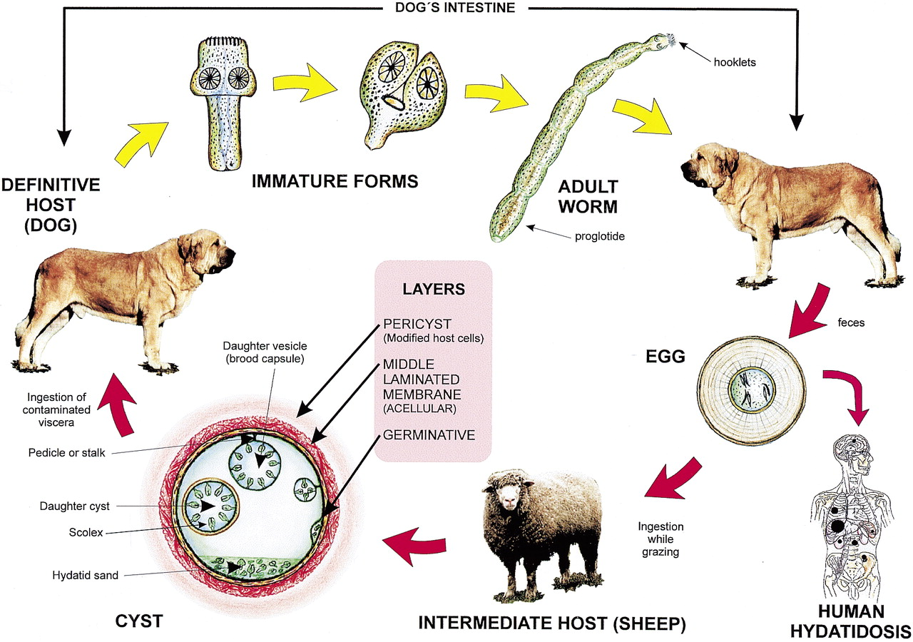
Life Cycle of E granulosus

Slide 5
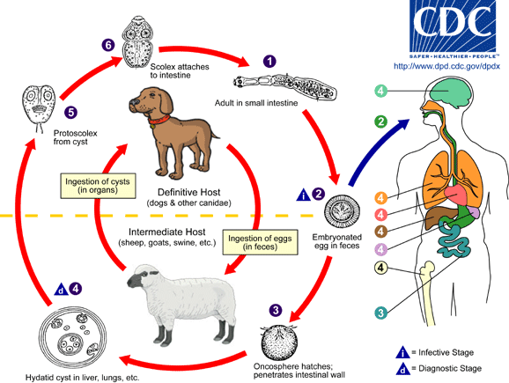

Slide 6
Hydatid Cyst Structure
The hydatid cyst has three layers:
(a) the outer pericyst, composed of modified host cells that form a dense and fibrous protective zone;
(b) the middle laminated membrane, which is acellular and allows the passage of nutrients;
(c) the inner germinal layer, where the scolices (the larval stage of the parasite) and the laminated membrane are produced.

Slide 7
Daughter vesicles (brood capsules) are small spheres that contain the protoscolices and are formed from rests of the germinal layer. Before becoming daughter cysts, these daughter vesicles are attached by a pedicle to the germinal layer of the mother cyst. At gross examination, the vesicles resemble a bunch of grapes.

Slide 8
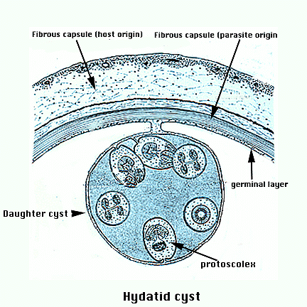

Slide 9
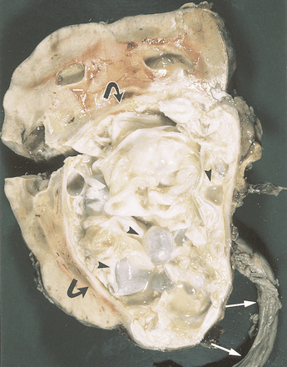

Slide 10
Widely distributed in most parts of the world where sheep are reared and dogs used to herd livestock. Endemic in mediterranean countries, Middle East, Southern S. America, Iceland, Australia, New Zealand and Southern Africa.
N. Western Turkana.
Risk factors: feeding dogs with raw offal and access of dogs to sheep that die in the field.
Variable incubation period. Upto several years.
Variable rate of cyst growth.
Most are asymptomatic.

Slide 11
Clinical features.
Liver 60-70 % , lungs 30-40 % muscles 5 %, bones 3 %, kidney 2 %, brain and spleen 1 % each.
Most symptomatic cysts are > 5 cm.
Hepatomegaly +/- RUQ mass. Obstructive jaundice, mild epigastric pain, indigestion, nausea.
Secondary infection- hepatic abscess.
Lung: cough, hemoptysis, dyspnoea, fever.
Brain cysts: intracranial hypertension, seizures.
Vertebral cysts: spontaneous fractures and deformities.
Sudden rupture: peritonitis, pneumothorax, empyema.
Rupture: allergic reaction, pruritus, edema, dyspnoea, anaphylactic shock and even death.

Slide 12
Diagnosis
SOL and residence in an endemic region.
Abdominal U/S.
CXR.
CT scan.
Serology. Antibodies have a low sensitivity for detection of lung hydatid and cross react serum of patients with T. solium.
Parasite identification in sputum samples of patients whose lung cysts have recently ruptured.
NB: Casoni test.

Slide 13
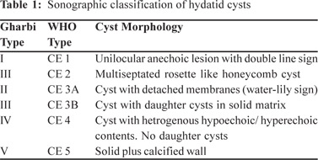

Slide 14
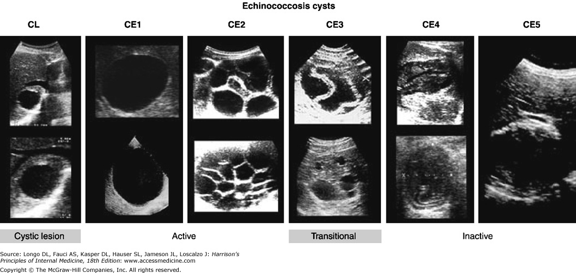

Slide 15
Management
Surgery.
Aspiration of cyst and injection of a protoscolicidal agent into the cyst. 20 % hypertonic saline/90 % alcohol, evacuation then surgical removal.
Risk: spillage of fluid and scolices into peritoneal cavity- anaphylaxis.
Secondary peritoneal hydatidosis.
Recurrence upto 30 %.
Antihistamines.

Slide 16
Surgical Management
Indications:
1-Large liver cysts with multiple daughter cysts; superficially located single liver cysts that may rupture (traumatically or spontaneously).
2-liver cysts with biliary tree communication or pressure effects on vital organs or structures.
3-infected cysts .
4-cysts in lungs, brain, kidneys, eyes, bones .

Slide 17
b. Chemotherapy.
Albendazole 10-15 mg/kg for 28 days separated by 2 week intervals. Optimal duration 3-6 months.
Mebendazole 40-50 mg/kg/day.
ABZ prophylaxis 1-3 months before surgery.
Praziquantel + ABZ.
Monitor LFTs and CBC.
Oxfenidazole.
Response: 30 % had cyst disappearnce (cure), 30-50 % decrease in cyst size ( improvement) and 30-40 % no changes.

Slide 18
Medical therapy:
Indications: Chemotherapy is indicated in patients with primary liver or lung cysts that are inoperable (because of location or medical condition), patients with cysts in 2 or more organs, and peritoneal cysts.
Chemotherapeutic agents: Two benzimidazoles are used, albendazole and mebendazole. Albendazole is administered in several 1-month oral doses (10-15 mg/kg/d) separated by 14-day intervals. The optimal period of treatment ranges from 3-6 months, with no further increase in the incidence of adverse effects if this period is prolonged. Mebendazole is also administered for 3-6 months orally in dosages of 40-50 mg/kg/d.

Slide 19
c. Percutaneous aspiration, injection and reaspiration. (PAIR).

Slide 20
PAIR
This technique, performed using either ultrasound or CT guidance, involves aspiration of the contents via a special cannula, followed by injection of a scolicidal agent for at least 15 minutes, and then reaspiration of the cystic contents. The cyst is then filled with isotonic sodium chloride solution. Perioperative treatment with a benzimidazole is mandatory (4 d prior to the procedure and 1-3 mo after).
The cysts should be larger than 5 cm in diameter and type I or II according to the Gharbi ultrasound classification of liver cysts

Slide 21
E. multilocularis and E. vogeli

